Slide 1
Weather Recognition User's guide
26.4.2023

Slide 2

HELLO!
We are team SOFTFORU from ShangHai.
Team leader:HAN KAIXUAN
Interface Designer: SUN YIYANG

Slide 3

Assessing Needs

Slide 4

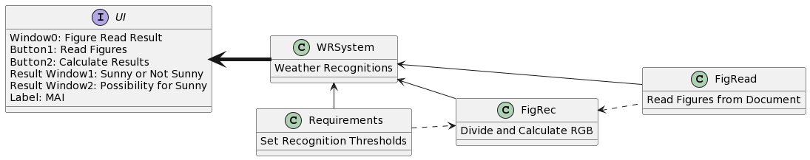
Class diagram
Code:
Define Task Paths and Code Modules
@startuml
left to right direction
class WRSystem {
Weather Recognitions
}
interface UI{
Window0: Figure Read Result
Button1: Read Figures
Button2: Calculate Results
Result Window1: Sunny or Not Sunny
Result Window2: Possibility for Sunny
Label: MAI
}
class FigRead{
Read Figures from Document
}
class FigRec{
Divide and Calculate RGB
}
class Requirements{
Set Recognition Thresholds
}
FigRec <.. FigRead
Requirements..>FigRec
WRSystem <--FigRead
WRSystem <-down- FigRec
WRSystem <-right- Requirements
WRSystem -[thickness=5]up-> UI
@enduml

Slide 5
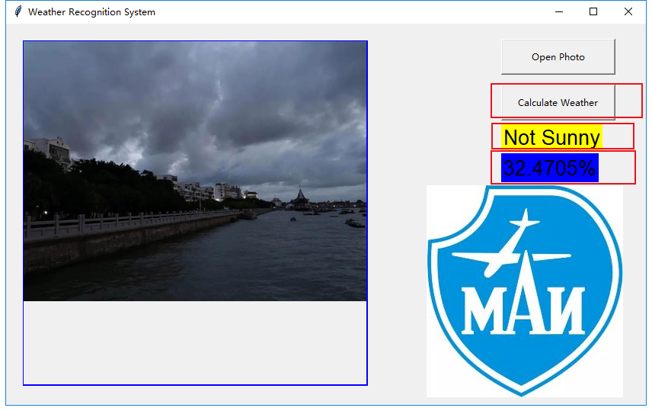
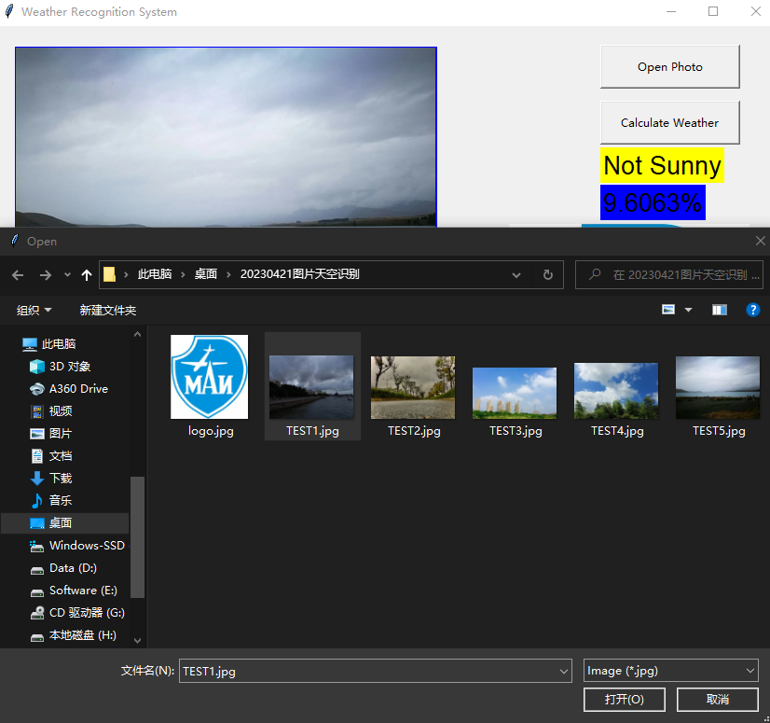
Usage Process
①Click “Open Photo” Button, Choose the target photo
②Click “Calculate Weather” Button, the result will be shown under this button.
Two kinds of results: Sunny or Not Sunny
Possibility of Sunny: P<50%, Not Sunny
P>50%, Sunny

Slide 6
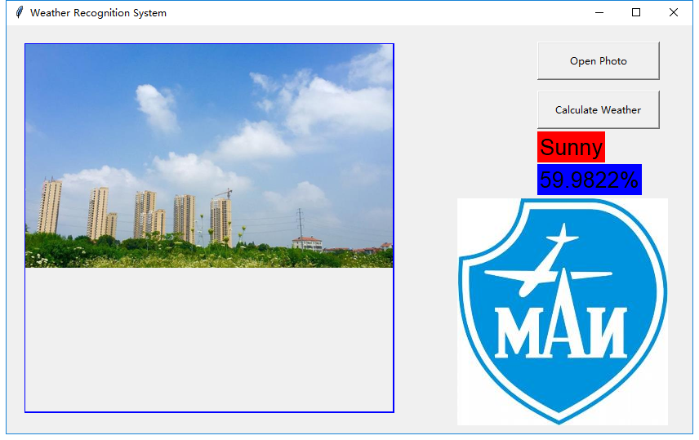
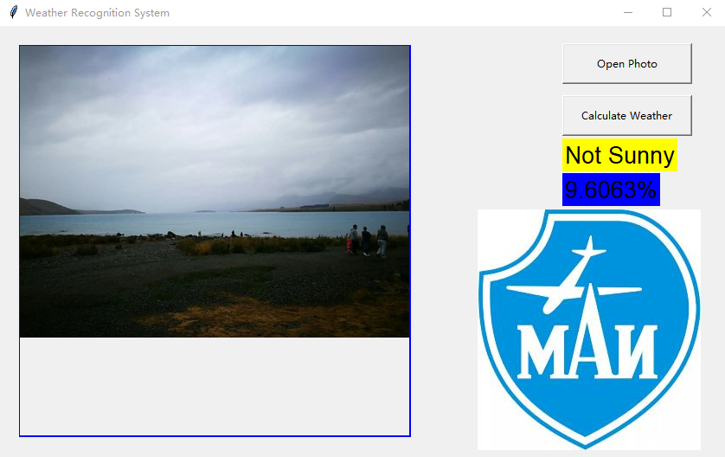
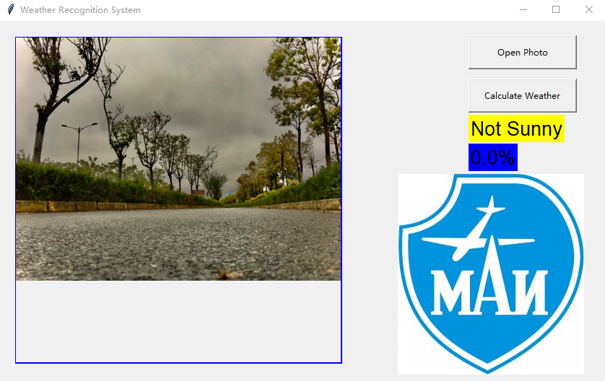
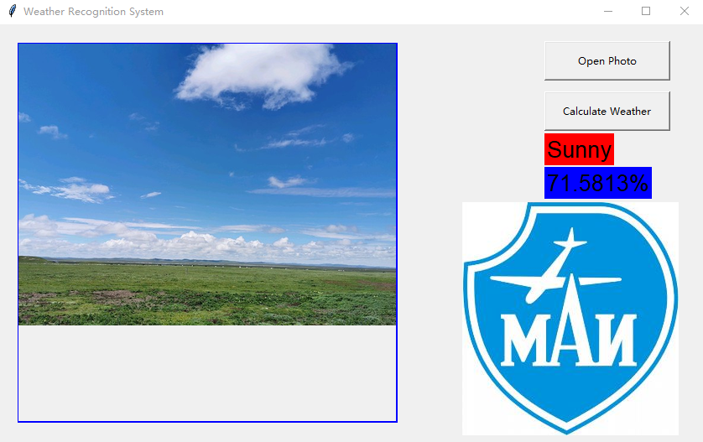
Case Realisation
Pretty Reliable

Slide 7


Weather Recognition System
Github link: https://github.com/KaixuanHan/MAI-SFT-ENG
File Name: Weather Recogntion System

Slide 8

THANKS!
Any questions?

